Slide 1
BT201
Biochemical Process Calculations
17/11/2022
Tutorial

Slide 2
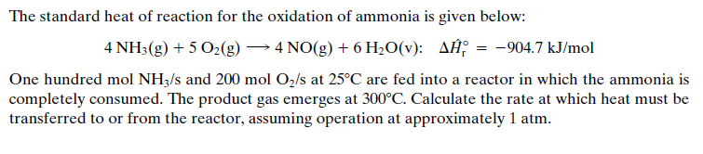
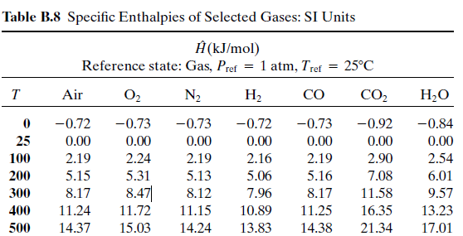
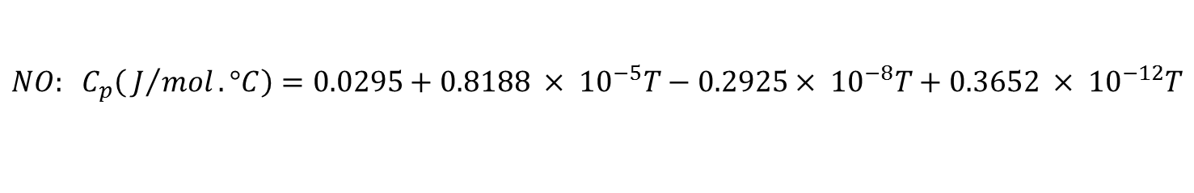
Problem 1
$$NO: C_{p}\left( J/{mol}.°C\right)=0.0295+0.8188 × {10}^{−5}T−0.2925× {10}^{−8}T+0.3652 × {10}^{−12}T$$

Slide 3
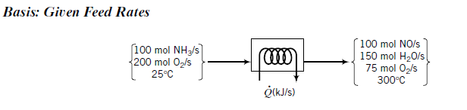

Slide 4

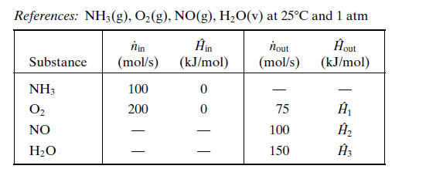

Slide 5
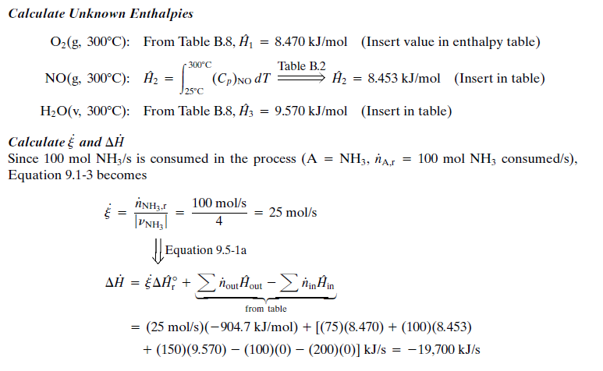

Slide 6
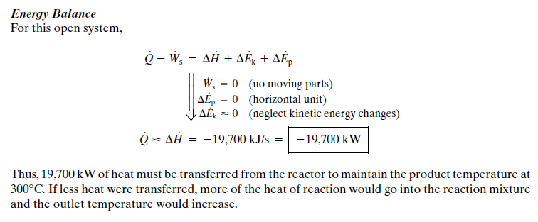

Slide 7
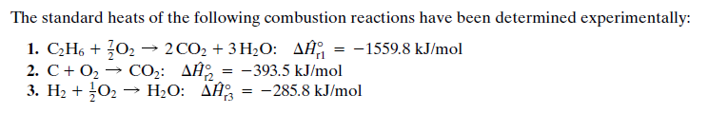

Problem 2

Slide 8
